Slide 1


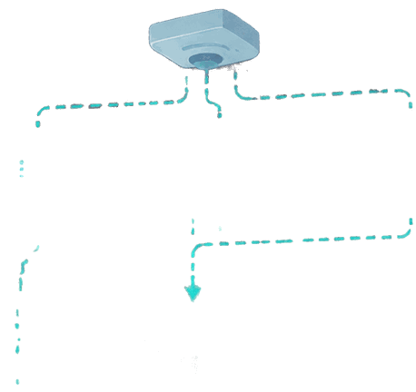






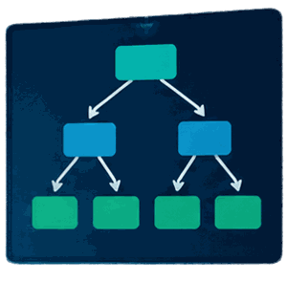





Institution: RP-KIGALI COLLEGE
Course: MACHINE LEARNING
Group: 10
Lecturer: INNOCENT
Date: 26/10/2026
RECOMMENDATION
Students and registration numbers:
IRABISHOBOYE Gilbert 26RP00139
MFITUMUKIZA Deogratias 26RP02925
SMART CLASSROOM ENERGY SYSTEM

Slide 2
02 • PROJECT SCOPE
Aim and Objectives
AIM
Develop a machine-learning prototype that recommends classroom lighting status from selected classroom conditions.
01
Prepare and inspect the demonstration dataset.
02
Train a Decision Tree Classification model.
03
Use light, motion, time and schedule inputs.
04
Present predictions in a Streamlit dashboard.
05
Identify what is needed for real IoT deployment.
SMART CLASSROOM ENERGY SYSTEM
03

Slide 3

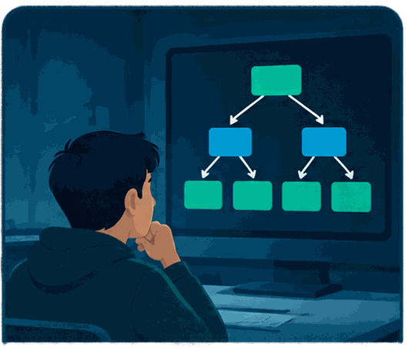

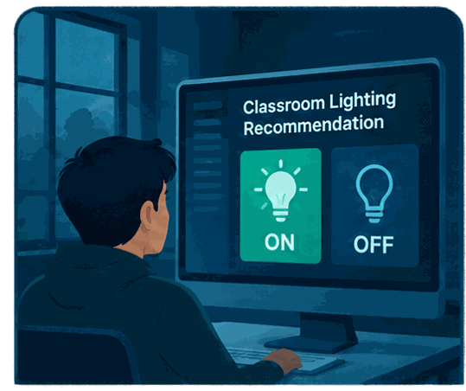






Aim and
objectives
light level
motion or occupancy
time
Aim:
Use
Prepare
build a Decision Tree Classification system that recommends classroom lighting as ON or OFF.
light level, motion or occupancy, and time as intended inputs.
data, develop a model,
and present recommendations in a Streamlit dashboard.

Slide 4
03 • PROPOSED METHOD
System Workflow
1
2
3
4
5
INPUTS
DATA
MODEL
OUTPUT
DASHBOARD
Light level
Motion
Hour + schedule
Validate rows
Select features
Check labels
Decision Tree
Classification
ON / OFF
recommendation
Streamlit UI
History + estimate
SMART CLASSROOM ENERGY SYSTEM
04

Slide 5



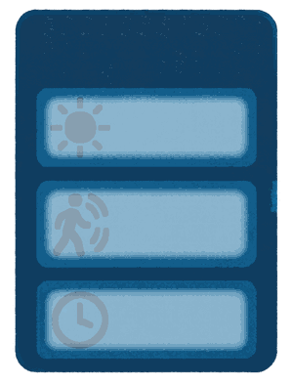






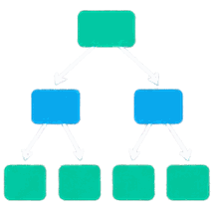









System
workflow
  Inputs: light level, motion or occupancy, and time.
SENSOR INPUTS
DATA PREPARATION
DECISION TREE CLASSIFICATION
LIGHTING RECOMMENDATION
  Prepared features are passed to a Decision Tree Classification model.
Light level
ON
Motion or occupancy
OFF
  The model produces an ON/OFF lighting recommendation.
Time

Slide 6
Data Preparation
✓
Inspect
Check columns, types and missing values.
✓
Validate
Check hour range, binary inputs and ON/OFF labels.
✓
Select
Use four inputs: lux, motion, hour, scheduled day.
✓
Split
80% training and 20% held-out test records.
✓
Document
Record synthetic origin and limitations.
SMART CLASSROOM ENERGY SYSTEM
06

Slide 7
06 • MACHINE-LEARNING METHOD
Decision Tree Classification
A Decision Tree learns a sequence of feature-based splits and predicts a class at a leaf node.
Light level ≤ threshold?
YES
NO
Motion detected?
Check time / schedule
ON
OFF
OFF
SMART CLASSROOM ENERGY SYSTEM
07

Slide 8

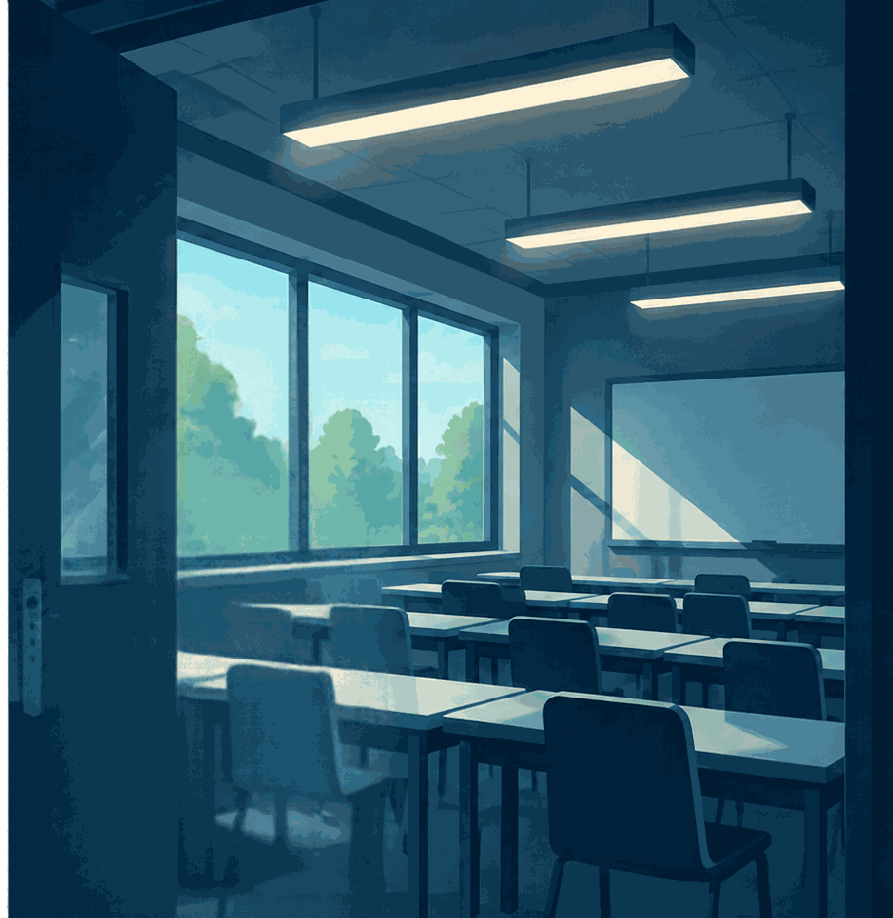







Why smart
classroom lighting?
Lights may remain on when a classroom
is unoccupied.
Daylight conditions can change the need for artificial lighting.
A timely recommendation could help inform more deliberate lighting decisions.

Slide 9
09 • MEASURED FROM THE SUPPLIED SYNTHETIC CSV
Model Results and Evaluation
2,400
1,920
480
100%
Total records
Training records
Test records
Held-out synthetic test accuracy
CLASS DISTRIBUTION
INTERPRETATION
OFF: 2,301 records
ON: 99 records
The target is imbalanced.
The model reproduces the synthetic labels on this held-out split. It has not been validated against real classroom measurements.
SMART CLASSROOM ENERGY SYSTEM
10

Slide 10
11 • FUTURE WORK
Limitations and Proposed Improvements
REAL DATA
Collect labelled readings from an actual classroom.
EXTERNAL DATA
Download and inspect the Kaggle dataset; verify feature meanings and licence.
VALIDATION
Test on independent real data and report class-wise metrics.
HARDWARE
Design and test sensors, controller, relay and manual override safely.
ENERGY MEASUREMENT
Record actual operating time and power before claiming savings.
SMART CLASSROOM ENERGY SYSTEM
12

Slide 11


















Preparing
the data
Light
Target Label
1.
Inspect the dataset columns, missing values, and available records.
Occupancy
ˈɑsərveɑ ɪɪʃ
lɪɑɑəvɛd lðɪɯɛɢ
Time
2.
Select only verified features relevant to light, occupancy, and time.
Generated by documented rules
3.
Target-label method: [State whether labels are observed or generated by documented rules].

Slide 12









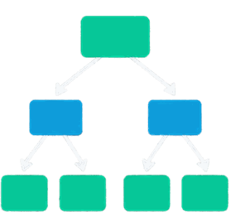















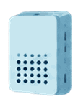
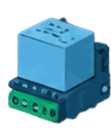
System
architecture
Data and
selected features
Preprocessing
Decision Tree
model
Streamlit dashboard
Recommendation
Physical sensors and relay: proposed integration,
not confirmed as implemented.

Slide 13


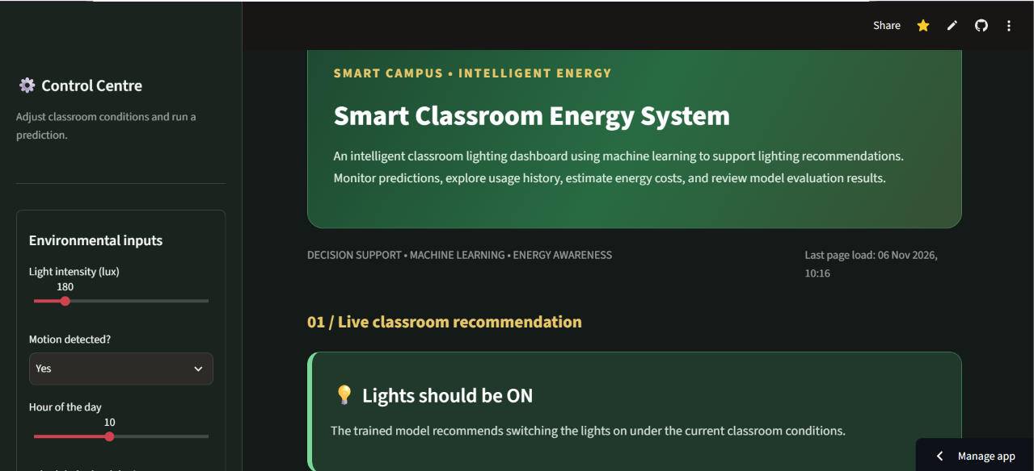

Dashboard
demonstration
[Insert genuine application screenshot]
Hosted application:
https://3v6q3zjts437wthpnh2b5h.streamlit.app/

Slide 14

References and Submission Links
HOSTED APPLICATION
https://3v6q3zjts437wthpnh2b5h.streamlit.app/
GITHUB SOURCE CODE
https://github.com/girbertirabishoboye-cloud/Smart-Classroom-Energy-System-/tree/main
KAGGLE Dataset SOURCE
https://www.kaggle.com/code/girbertirabishoboye/smart-classroom-final-model-joblib/edit
SMART CLASSROOM ENERGY SYSTEM
14

